Slide 1
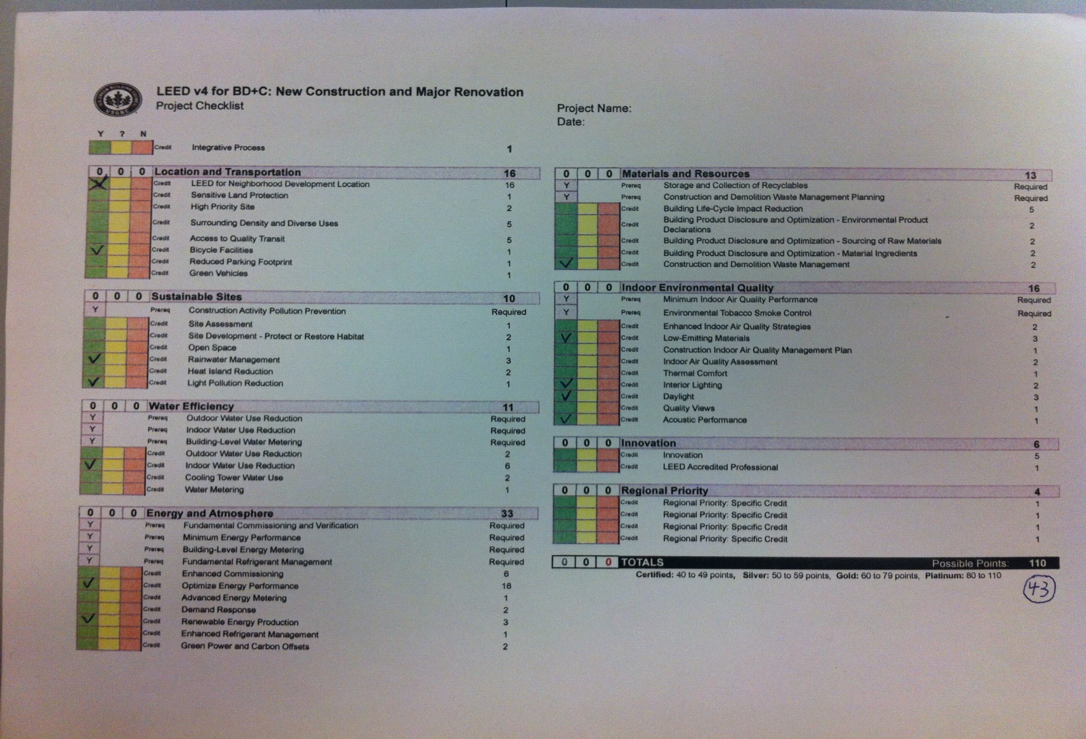
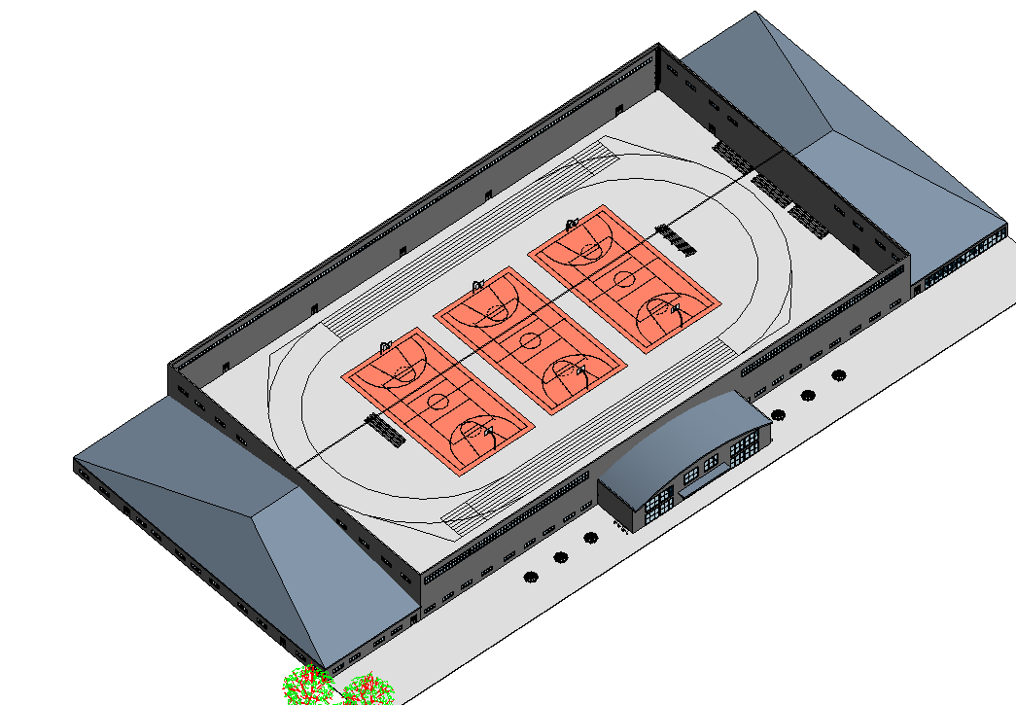
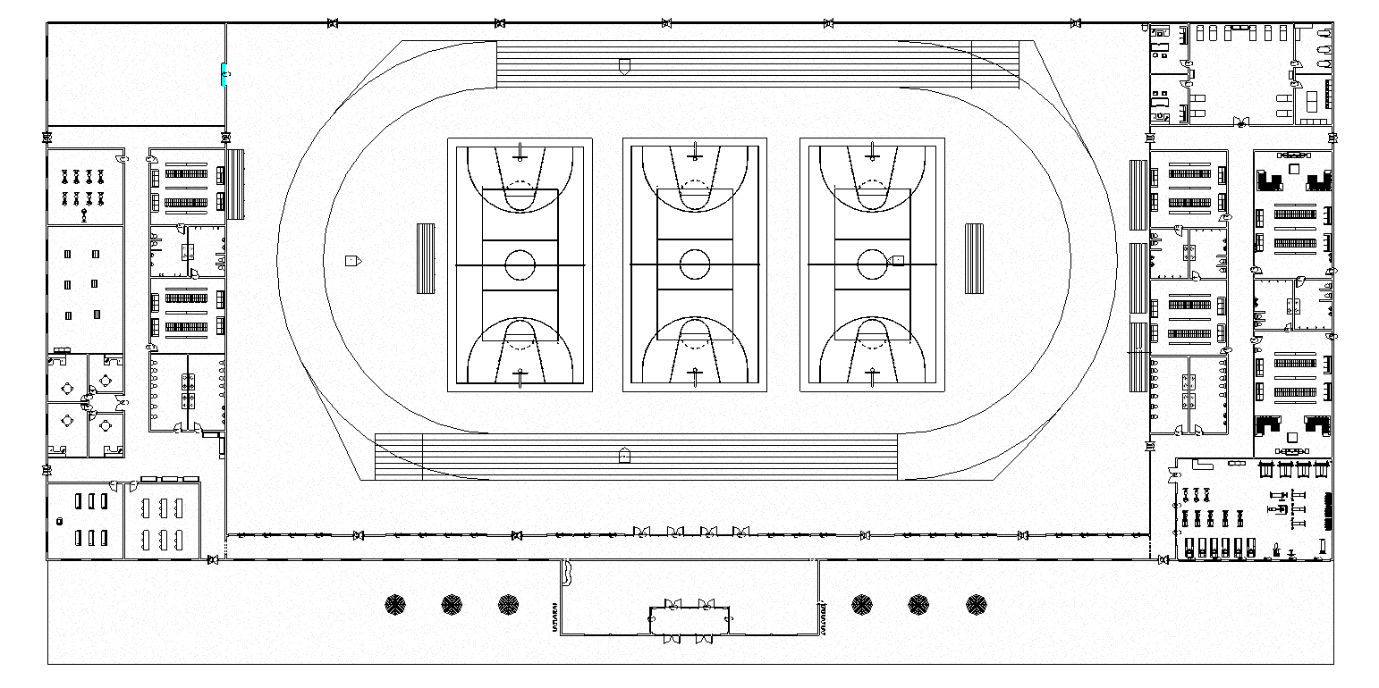
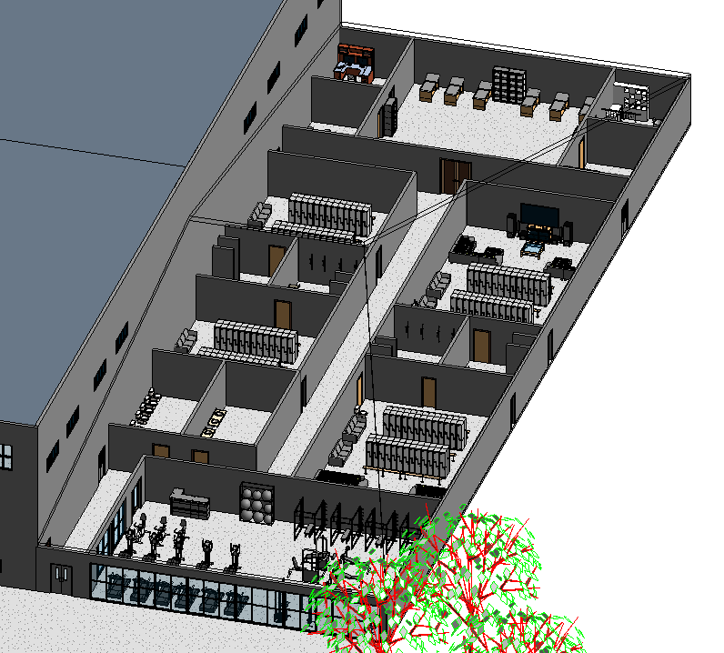
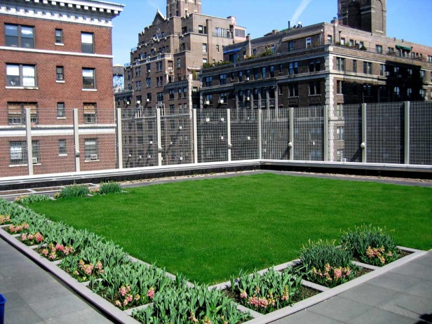
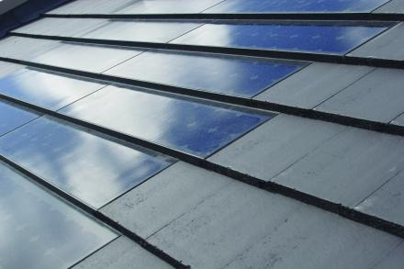
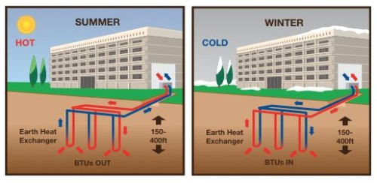
Elizabethtown College Wellness Center Proposal
Team Members: Zachary Karasek, Parke Martin, Ryan Shirk
Problem Statement
Space Allocation for the Building
Site Location
.
Elizabethtown College is looking to expand their wellness facilities. Our project was to propose a design for a new wellness facility that embodied mind, body, and spirit.
Floor plan area is 500x250 feet
Lobby space of 3000 square feet
86,400 square foot space that contains an indoor track, 3 basketball courts
2400 square foot weight room
2800 square foot sports medicine facility
2800 square feet of storage space
900 square foot class room
4500 square feet devoted to student wellness
 | Thompson Gym | Between Soccer and Lacrosse Fields | Behind Soccer Field | Off Campus Location
Workable Land | - | + | + | +
New Renovations | - | + | - | +
Space Needed | - | + | + | +
Accessibility | + | + | + | -
Aesthetics | - | - | + | -
 | 1 | 4 | 4 | 3
One of the main aspects of this project was choosing a location for this facility. After analyzing all of our options we chose to place the facility above the soccer field where the softball field is located. The Pugh table to left depicts our thought process. It displays the main factors in this decision.
LEED v4 Self-Assessment
3-D Rendering
Floor Layout
Sustainable Features
When looking at the results of the pue table we came to the conclusion that roofs all had good however they all had some sort of fault with them. With so much space on the roof we decided to choose two of roof designs and use them both for the building.
Green Roof:
This will allow use to collect and use rainwater for the buildings pluming
This will also provide insulation for the main room in the building
Solar Shingles:
This will help with providing energy for the building along with providing aesthetics
 | Green Roof | Blue Sheet Metal | Solar Roof | Datum
Aesthetics | + | + | + | +
Sustainability | + | - | + | -
Cost of Material | + | + | - | +
Cost of Installment | - | + | - | +
Life-span | + | + | + | +
 | 4 | 4 | 3 | 4
Geothermal heat is a great option for a building like this. It takes advantage of the earth’s constant core temperature, using it to heat and cool the building. These systems will save the school a lot of money that would have been spent powering a traditional HVAC system.
The Department of Engineering and Physics Elizabethtown College 2014

